Slide 1

Flight Management System: A Practical Application of DSA
Taha Shafique 2023716
Abdul Raheem Goraya 2023170

Slide 2
Project Motivation
Practical Impact
DSA Integration
The project aims to address real-world challenges faced by airlines, airports, and travelers.
The system leverages fundamental DSA concepts to manage complex flight operations efficiently.

Slide 3
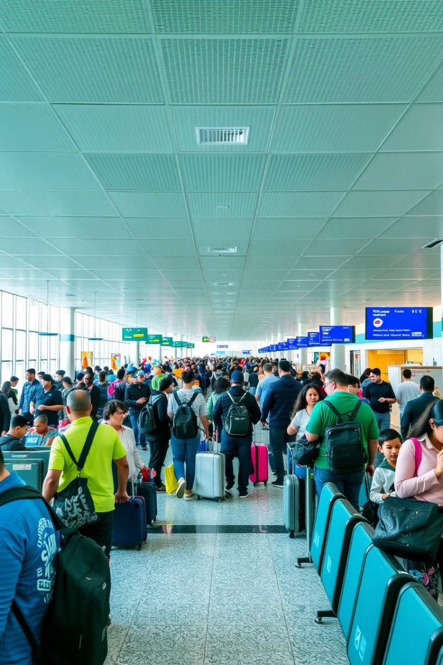
Real-World Challenges
1
Route Optimization
2
Schedule Management
Finding the shortest and most cost-effective paths between cities.
Storing and retrieving flight schedules efficiently based on departure and arrival times.
3
Dynamic Updates
4
User Accessibility
Allowing administrators to update city and route information in real time.
Simplifying the process for users to search and book flights.

Slide 4
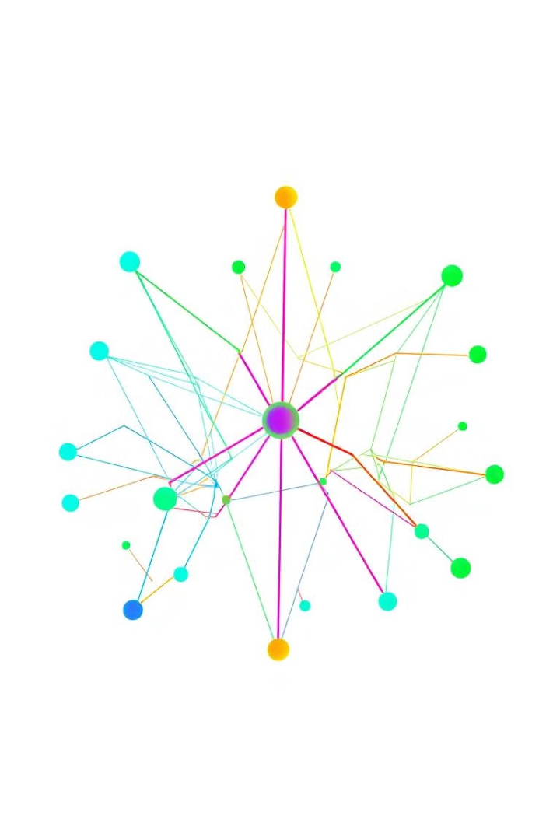
Solutions Implemented
Graph Data Structures
Dijkstra's Algorithm
Representing cities as nodes and flight routes as edges enables efficient route management and updates.
Calculates the shortest path between cities, ensuring optimal route recommendations for users. This solves the shortest path problem
Binary Search Tree (BST)
Dynamic Input Validation
Storing flight schedules as BST nodes allows fast retrieval of flight information based on departure times.
Functions like validCityPair ensure the integrity of user and admin inputs.

Slide 5




Algorithms Used
Graph Algorithms
BST Operations
Greedy Approach
Adjacency matrix stores route data, Dijkstra's algorithm computes shortest paths.
Insertions and searches are performed recursively.
Shortest path computation uses a locally optimal choice to ensure global optimization.

Slide 6




Code Description
1
Data Structures
Graph
2
Adjacency matrix represents flight routes and costs.
BST
3
Stores flight times for each route.
City List
4
Array holds city IDs and names.

Slide 7
Future Improvements
Scalability
1
Transition from adjacency matrix to adjacency list for larger networks.
2
Graph Algorithms
Implement A* Search for faster route planning with heuristics.
Flight Booking System
3
Extend the system to include flight booking and seat management functionalities.
4
Database Integration
Replace in-memory structures with a database for persistent and large-scale data storage.
User Interface (UI)
5
Introduce a graphical user interface (GUI) for better usability.
6
Real-Time Updates
Enable real-time updates for flight schedules and route information via API integrations.
Data Validation
7
Add more robust input validation and error-handling mechanisms for edge cases.

Slide 8

Conclusion
The Flight Management System project demonstrates the practical application of DSA concepts in solving real-world challenges. By addressing future improvements, the system can evolve into a comprehensive and impactful flight management application.

Slide 9
THANK YOU!!!!

